Slide 1



Wordpress setup
BY - VIBHANSHU KUMAR

Slide 2






Requirements
Database
Apache 2
PHP
Wordpress
Aws EC-2

Slide 3


TABLE OF CONTENT
1ST WE TAKE RDS SERVICES FROM AWS
CREATE DATA BASE
CREATE A INSTANCE (UBUNTU)
OPEN IN CMD START THE INSTALLAION OF ALL REQUIREMENTS FOR WORDPRESS
THEN COPY THE PUBLICK IP
SEARCH ON BROWSER
COMPLETE THE SETUP PROCESS

Slide 4
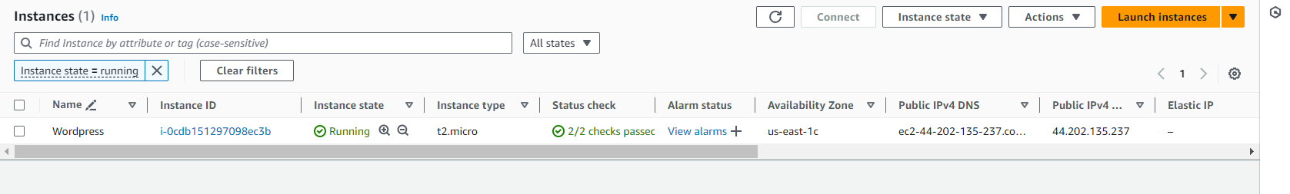
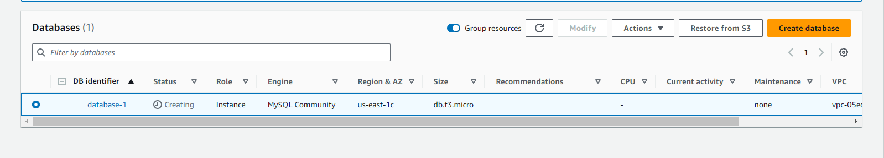
Creating A instance (ubuntu)
Creating A database from aws RDS sevices

Slide 5

Run the command --> sudo apt update
Run the command --> sudo apt upgrade

Slide 6
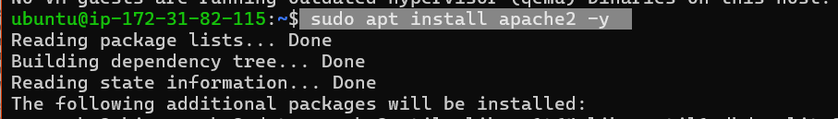
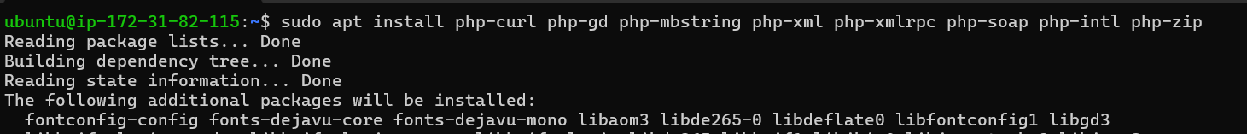
install apache 2
Run the command --> sudo apt install apache2
install php zip file
sudo apt install php-curl php-gd php-mbstring php-xml php-xmlrpc php-soap php-intl php-zip

Slide 7
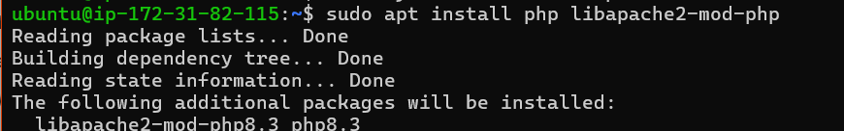
You’ll need to restart Apache to load these new extensions
Command -->> sudo systemctl restart apache2
Then download the compressed release with the following curl command
sudo apt install php libapache2-mod-php

Slide 8
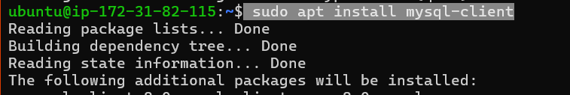
Install mysql client
command --> sudo apt install mysql-client

Slide 9
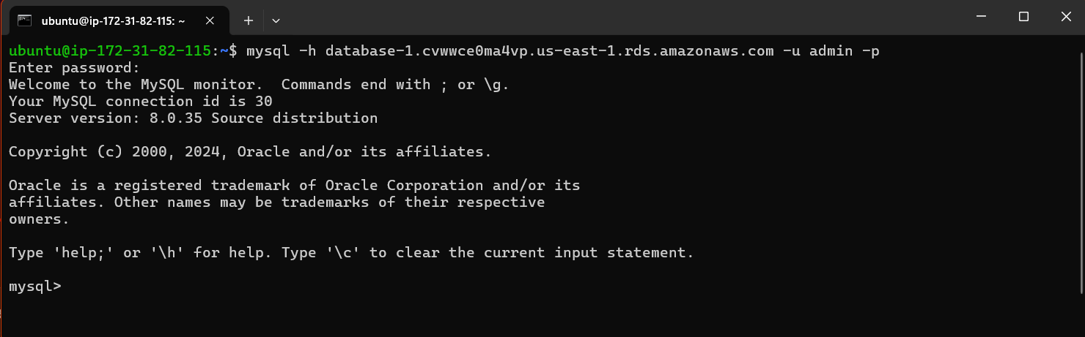
After installation mysql client
link your Database
command --> mysql -h database-1.cvwwce0ma4vp.us-east-1.rds.amazonaws.com -u admin -p
Command Syntax --> mysql -h + endpoint of rds DB + -u + admin -p
fill the Credantials

Slide 10
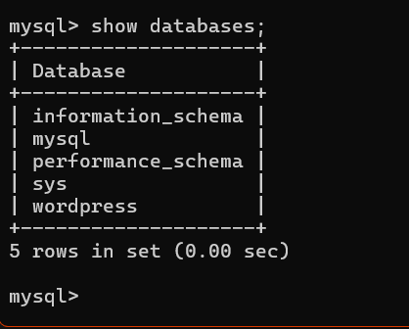
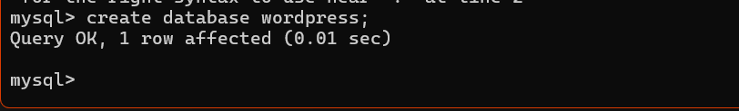
use cmd --> show databases;
u will see ur created database
Now u r in mysql client so
show create database name Wordpress
Command --> create database wordpress;

Slide 11
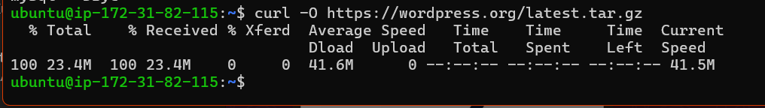
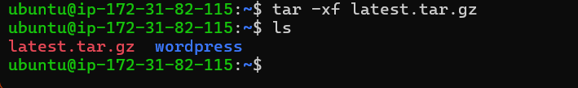
Now u download wordpress latest tar file
Command-->curl -O https://wordpress.org/latest.tar.gz
Command Syntax-->curl + file link
extract the file
after extraction u wille se file name as Wordpress

Slide 12
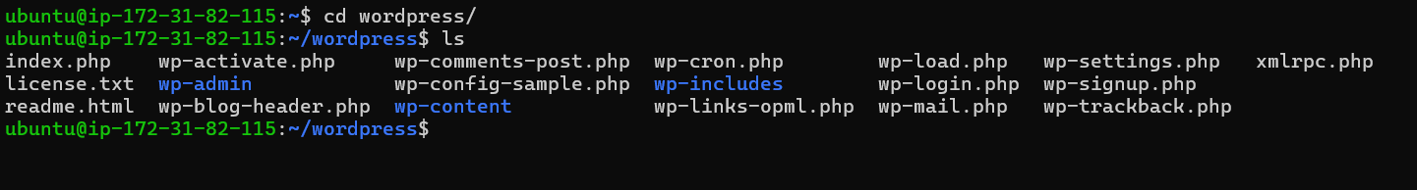
here u also check whats in wordpres
then copy the wordpress file to /var/www/html loaction

Slide 13
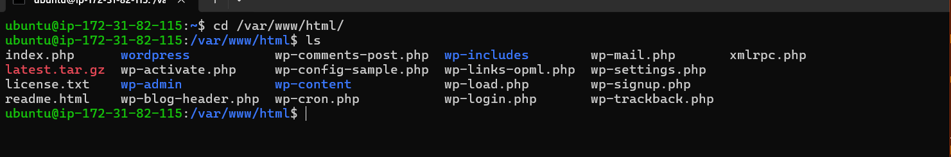

after copy u will go to the loaction where u can copy the file
then u remove the file (name index.html)

Slide 14
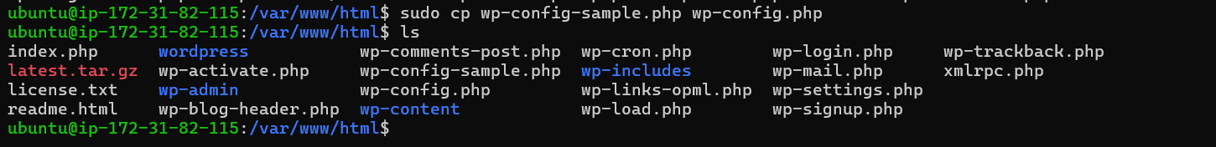
Then rename the file wp-config-sample.php to wp-config.php

Slide 15
the use command sudo vim wp-config.html
for edit some detais

Slide 16
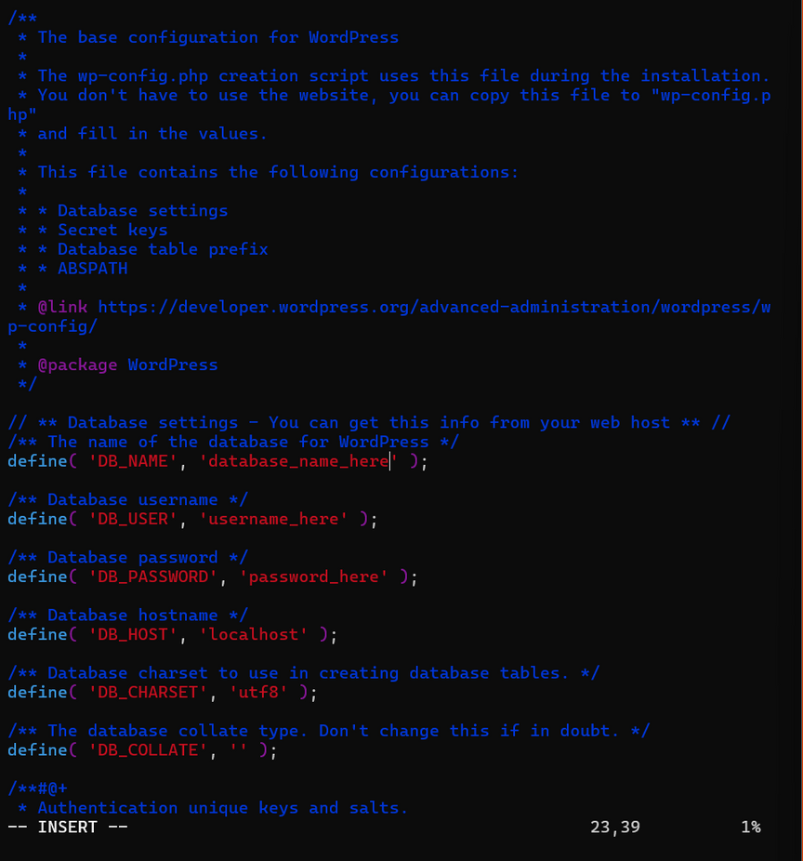
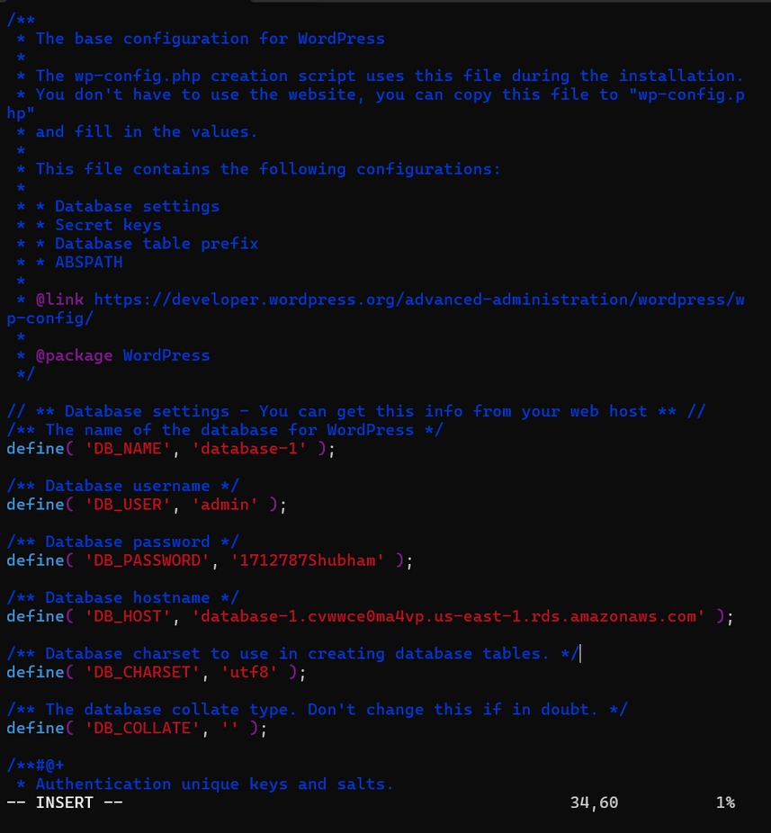

fill the details

Slide 17
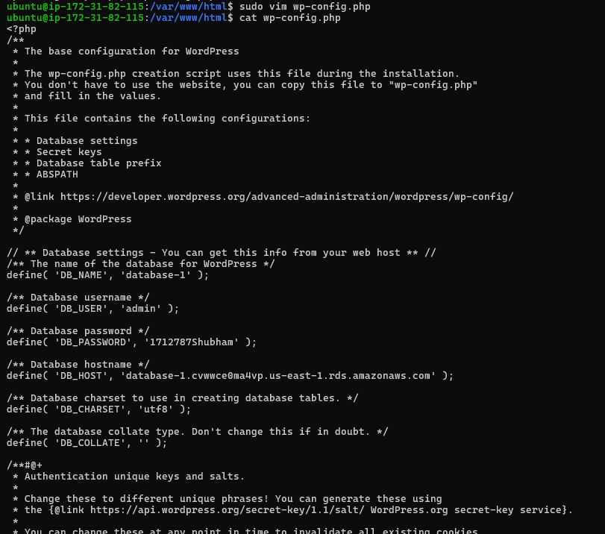
use of cat command u see the changes

Slide 18
again restart the apache2 server

Slide 19
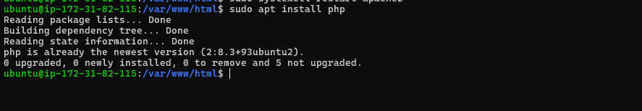
Then install php
command--> sudo apt install php

Slide 20
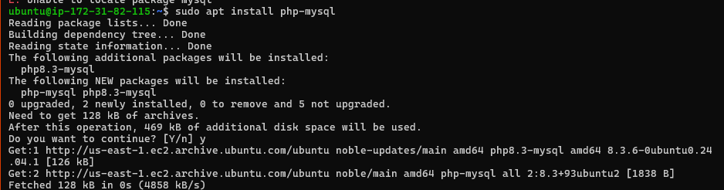
then install phpmysql
command--> sudo apt install php-mysql

Slide 21
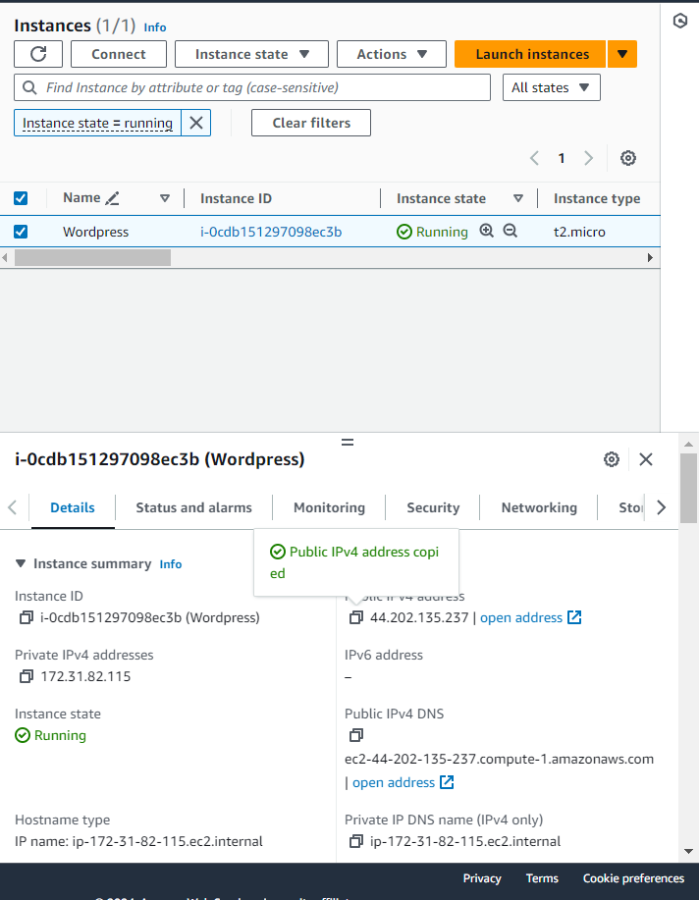

Go to the AWS instance
Copy the Public ip
Search on any browser

Slide 22
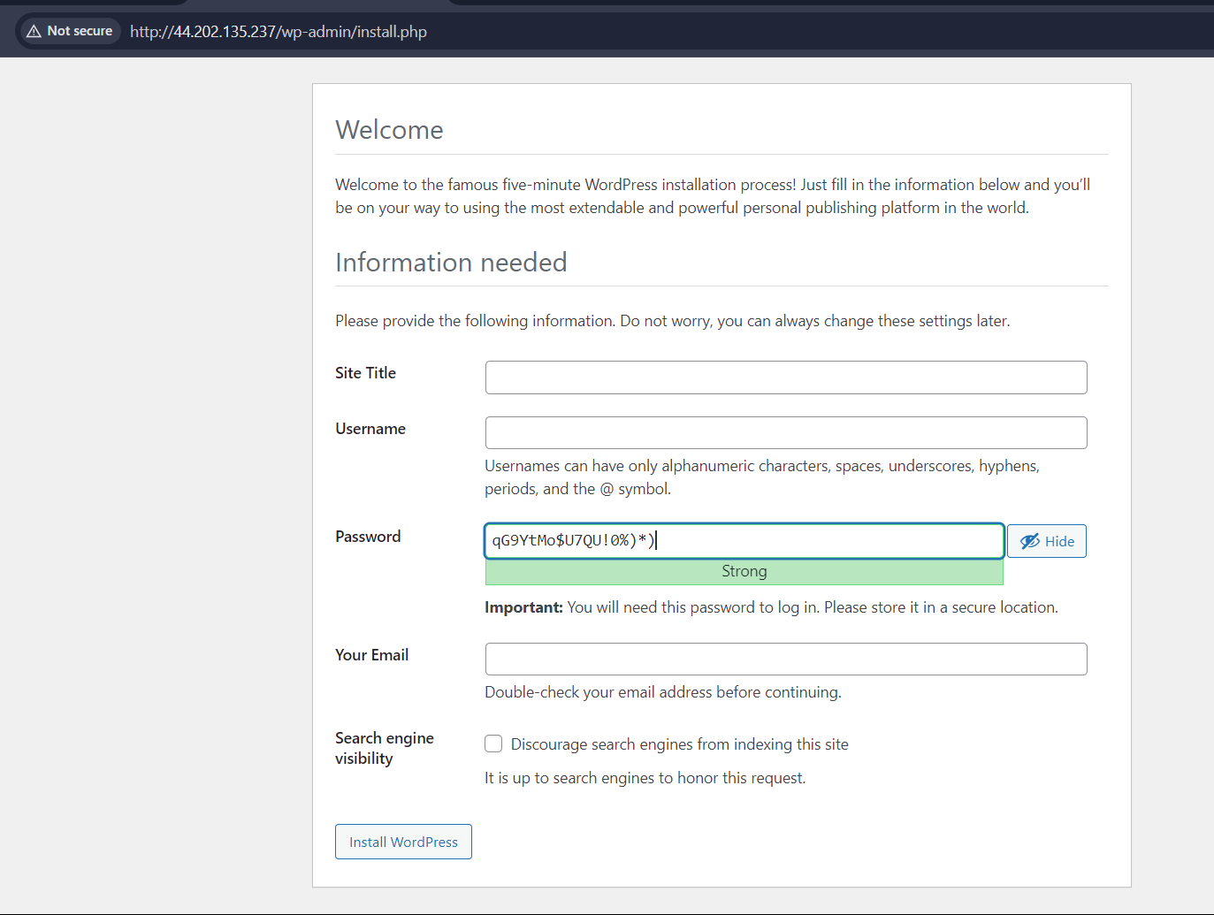
After search
Appear this type of interface
Fill the details

Slide 23
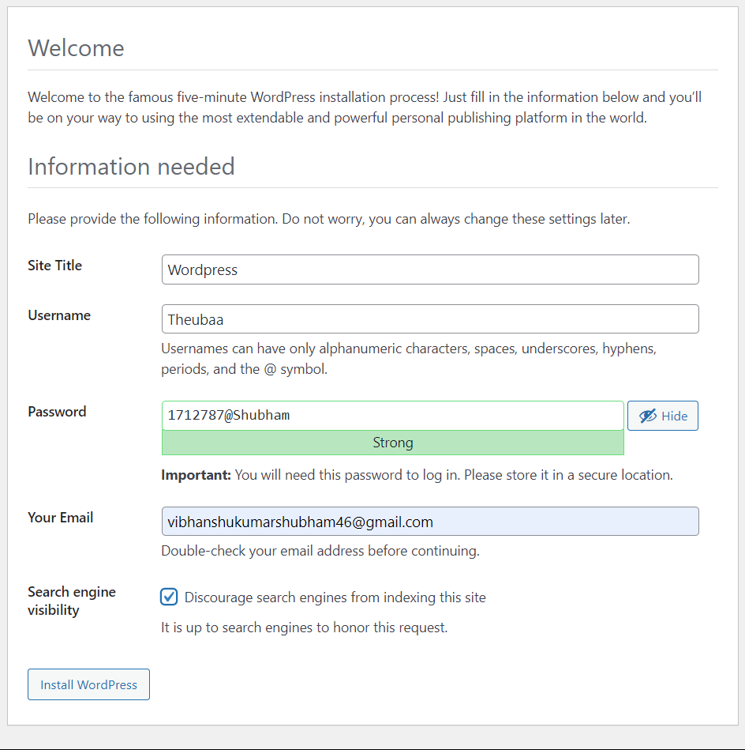
fill the details like this
Click on install wordpress

Slide 24
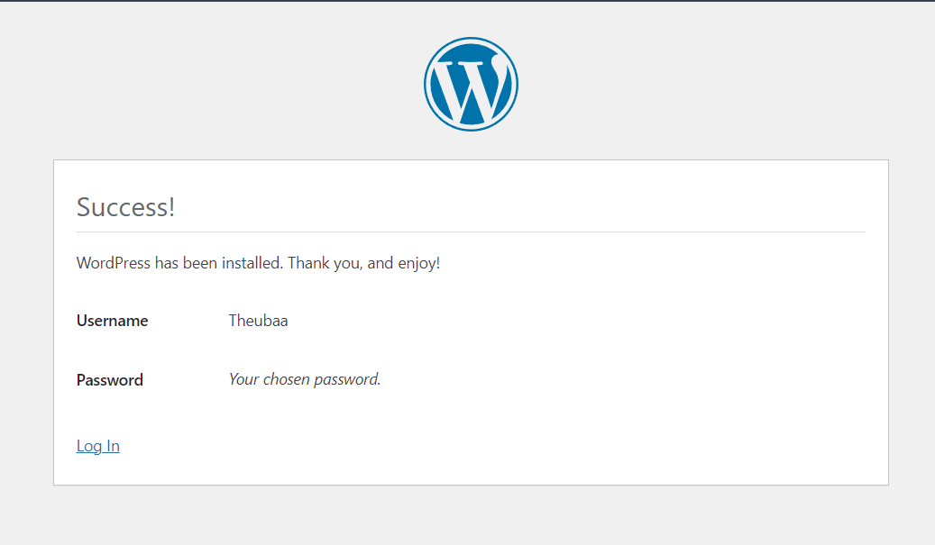
U will get succes notification
Click on the Login

Slide 25
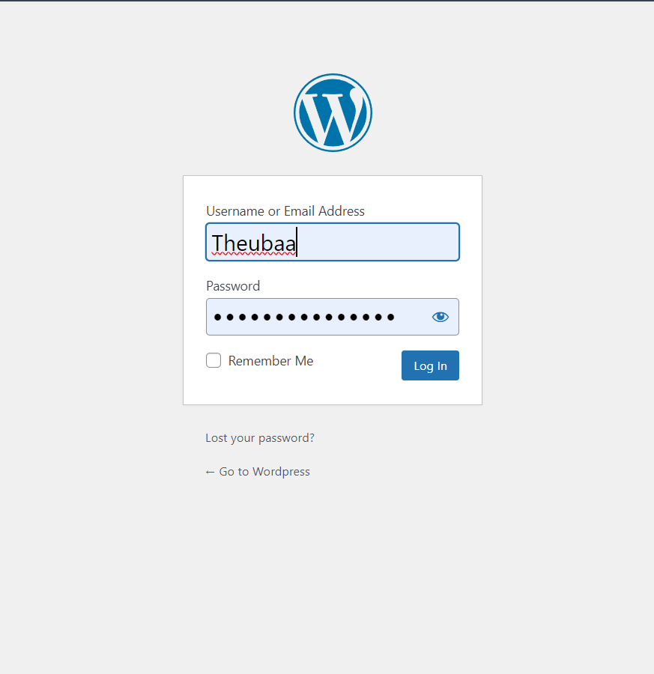
Fill the user id and password
and click on login

Slide 26
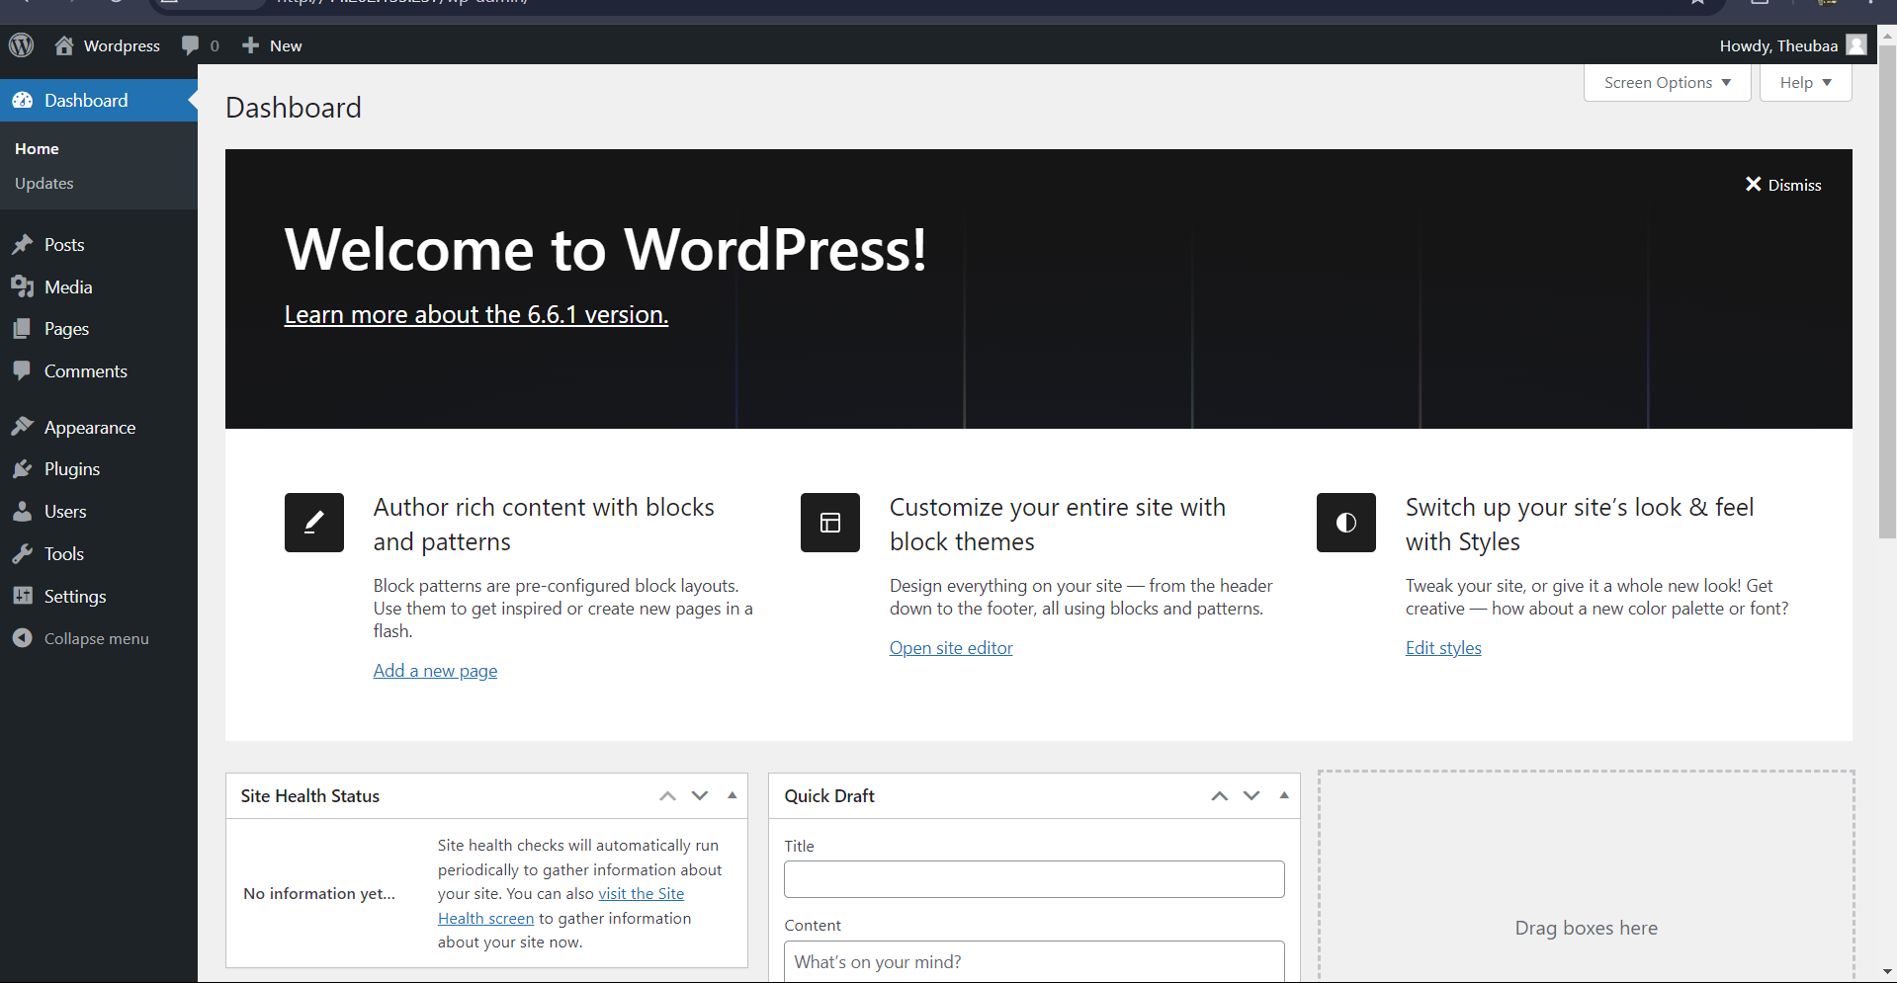
after login u will be come on wordpress home page (Dashboard)

Slide 27
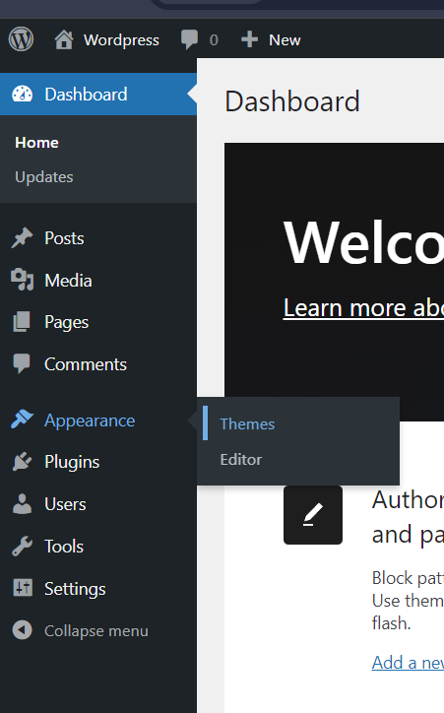

click on appearance
click on theme

Slide 28
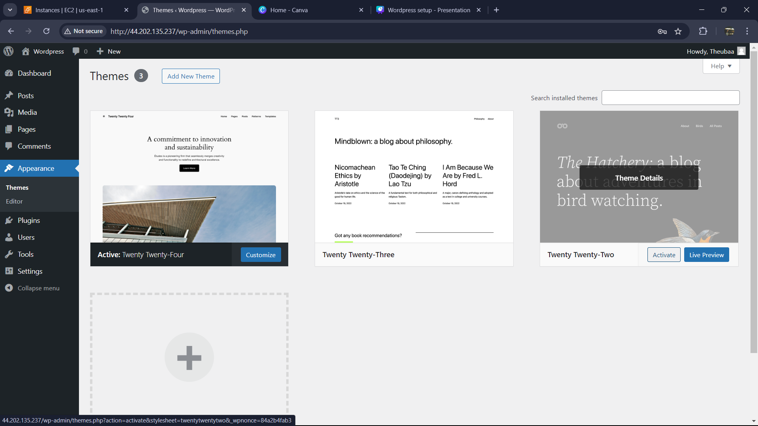
Choose any one theme and edit them

Slide 29
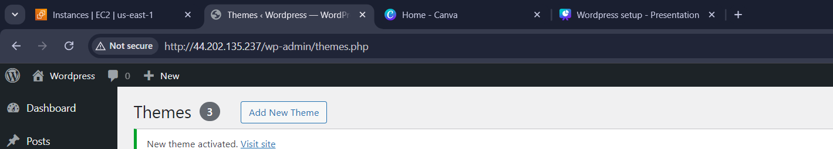
After customization the theme
click on the link and remove --> /wp-admin
Then click Enter

Slide 30
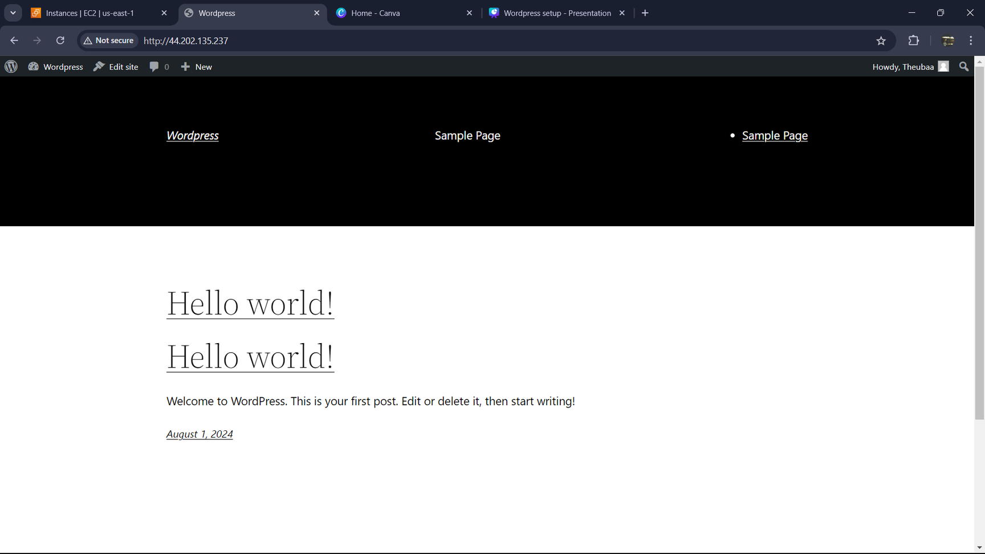
U will be redirect on your Website

Slide 31


Bingo
ur
wordpress
is
ready

Slide 32

thank you
See You Next time!

